Slide 1
Transport Layer Security (TLS)
The Internet Engineering Task Force (IETF) standard called Transport Layer Security (TLS) is based on SSL.

Slide 2
TLS Fundamentals
“Transport Layer Security” protocol
Standard protocol for encrypting Internet traffic Previously known as SSL (Secure Sockets Layer)
TLS replaced SSL in 1999
Used for HTTPS (HTTP Secure) traffic
Supported by nearly every web browser

Slide 3
Purposes for TLS
Data integrity
Server (and client) authentication
Confidentiality

Slide 4
TCP/IP Protocol Suite
The TCP/IP governs the transport and routing of data over the Internet.
Other protocols, such as the HyperText Transport Protocol (HTTP), Lightweight Directory Access Protocol (LDAP), or Internet Messaging Access Protocol (IMAP), run "on top of" TCP/IP in the sense that they all use TCP/IP to support typical application tasks such as displaying web pages or running email servers.

Slide 5
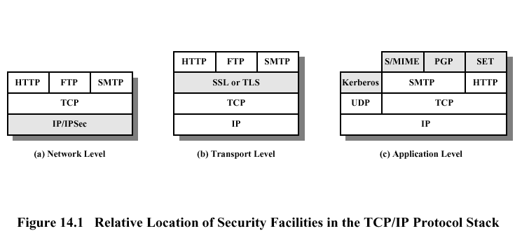
TCP/IP Protocol Suite and Security

Slide 6
Services Provided by TLS
TLS encrypts data so that no one who intercepts is able to read it.
TLS can assure a client that they are dealing with the real server they intended to connect to.
TLS can prevent any unauthorized clients from connecting to the server.
TLS prevents anyone from interfering with data going to or coming from the server.

Slide 7
Services Provided by TLS
TLS server authentication
TLS client authentication
An encrypted TLS connection

Slide 8
TLS Server Authentication
TLS server authentication allows a user to confirm a server's identity.
TLS-enabled client software can use standard techniques of public-key cryptography to check that a server's certificate and public ID are valid and have been issued by a certificate authority (CA) listed in the client's list of trusted CAs.
This confirmation might be important if the user, for example, is sending a credit card number over the network and wants to check the receiving server's identity.

Slide 9
TLS Client Authentication
TLS client authentication allows a server to confirm a user's identity.
Using the same techniques as those used for server authentication, SSL-enabled server software can check that a client's certificate and public ID are valid and have been issued by a certificate authority (CA) listed in the server's list of trusted CAs.
This confirmation might be important if the server, for example, is a bank sending confidential financial information to a customer and wants to check the recipient's identity.

Slide 10
An encrypted TLS connection
An encrypted TLS connection requires all information sent between a client and a server to be encrypted by the sending software and decrypted by the receiving software, thus providing a high degree of confidentiality.
Confidentiality is important for both parties to any private transaction.

Slide 11
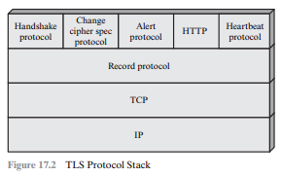
TLS Sub-protocols
The TLS protocol includes two major sub-protocols:
the TLS record protocol
the TLS handshake protocol

Slide 12
The TLS Record Protocol
The TLS record protocol defines the format used to transmit data
The TLS record protocols provides two services for SSL connections:
  Confidentiality: The Handshake Protocol defines a shared secret key that is used for conventional encryption of TLS payloads
  Message Integrity: The Handshake Protocol also defines a shared secret key that is used to form a message authentication code (MAC)

Slide 13
The TLS Handshake protocol
The most complex part of TLS is the Handshake Protocol.
This protocol allows the server and client to authenticate each other and to negotiate an encryption and MAC algorithm and cryptographic keys to be used to protect data sent in a TLS record.
The Handshake Protocol is used before any application data is transmitted.

Slide 14
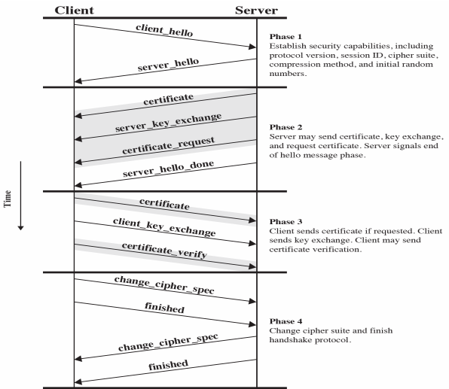

Slide 15
